Slide 1

DCS WORLD MISSION DESIGN SCRIPTING TUTORIALS

Slide 2
What has been learned…
Some people have a lot of programming experience, but many lack any experience with coding or scripting.
Some people have coding experience, but never used lua.
Some people never used an object oriented system.
Many people are afraid of starting, or have given up.
Some solutions were too complex for novice users. Many expect a ‘script’ that does what it does without many configurations.
What to do, if it doesn’t work… Where to go?

Slide 3
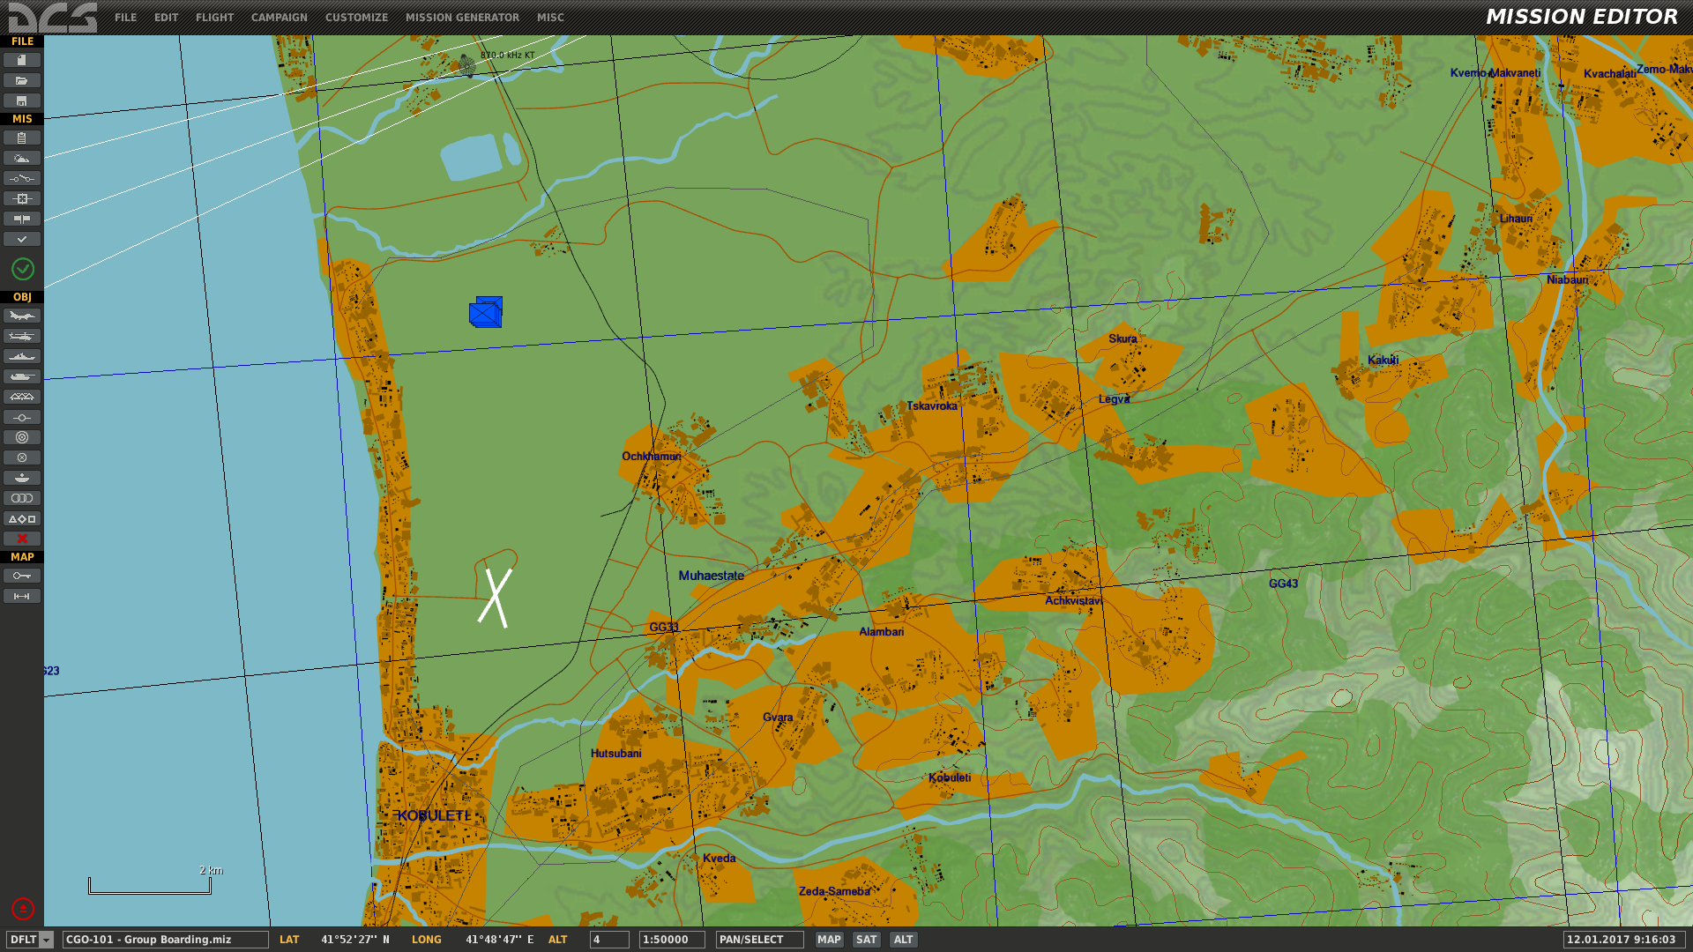
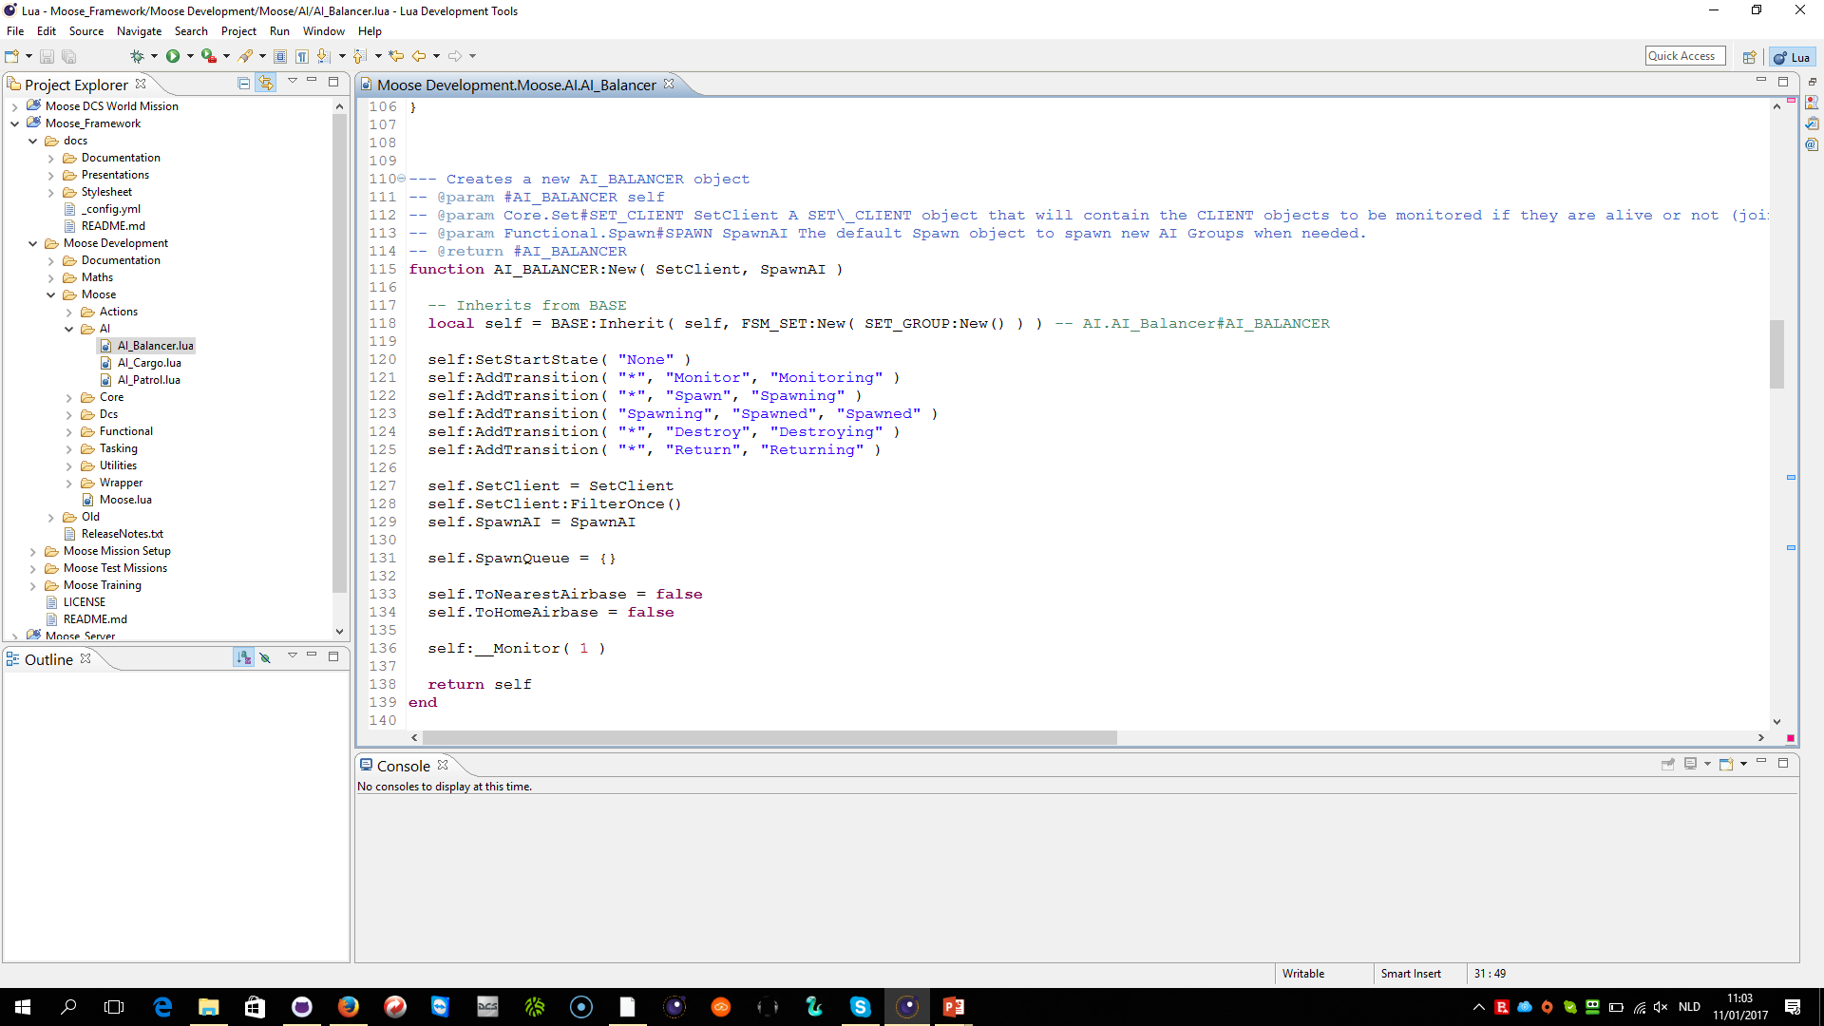
FANCY MISSIONS HARMONIZE MISSION EDITOR CAPABILITIES AND SCRIPTS
HARMONIZE

Slide 4
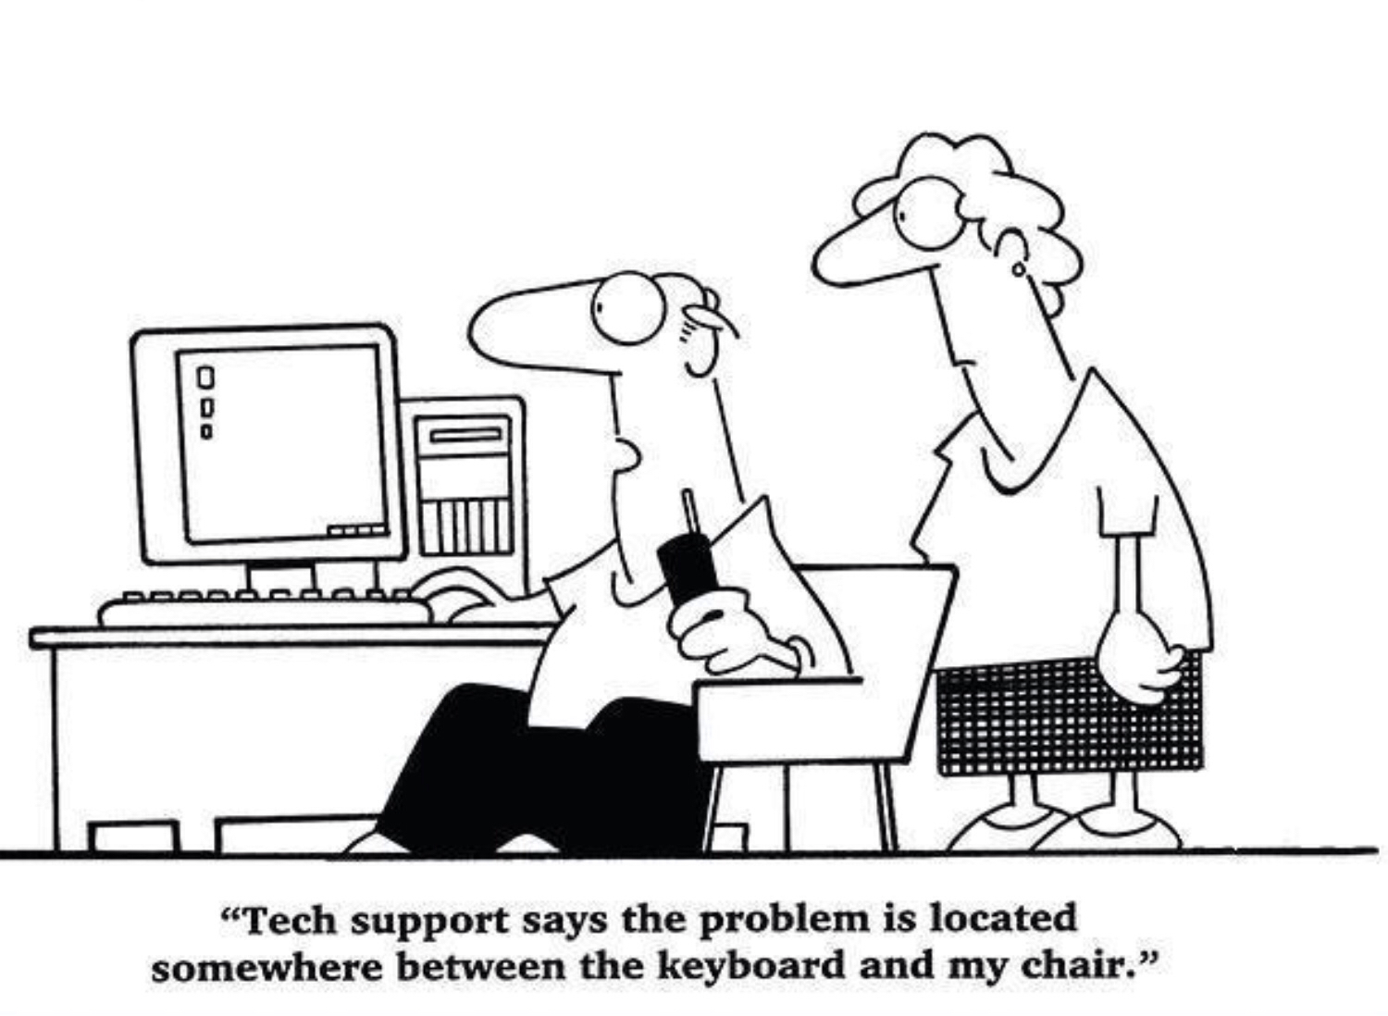
CHALLENGE Make the broad audience good mission designers

Slide 5
WHAT IS TO BE LEARNED …
Tutorial: How to embed your scripts in the DCS Mission Editor.
Tutorial: How to setup your environment for scripting and what options you have.
Tutorial: Lua Basics (you don’t need to be a lua expert!).
Tutorial: Overview of MOOSE and where to find the information.
Tutorial: How to quickly build missions.
Tutorial: How you will learn … Share the best practices!
…

Slide 6
SCRIPTING
IS FUN !

Slide 7
MOOSE FRAMEWORK
FUNCTIONAL CLASSES
TASKING & MISSIONS
AI ORCHESTRATION
SPAWN
MISSILETRAINER
COMMANDCENTER
AI_A2A_DISPATCHER
AI_A2A_GCICAP
AI_A2A_INTERCEPT
FORMATION
AIRBASEPOLICE
MISSION
AI_A2G_DISPATCHER
AI_A2G_AFAC
AI_A2G_BAI
ESCORT
CLEANUP
TASK_A2A_DISPATCHER
TASK_A2N_DISPATCHER
AI_G2G_DISPATCHER
AI_G2G_GUARD
AI_G2G_ARTILLERY
FOLLOW
SEAD_DEFENSE
TASK_G2G_DISPATCHER
TASK_A2G_DISPATCHER
AI_A2N_DISPATCHER
AI_A2N_GUARD
AI_A2N_SHIPSTRIKE
DETECTION
MOVEMENT
TASK_A2G_SEAD, TASK_A2G_BAI, TASK_A2A_SWEEP, …
AI_N2N_DISPATCHER
AI_A2N_GUARD
AI_N2N_ATTACK
MOOSE WRAPPER CLASSES
OBJECT
IDENTIFIABLE
POSITIONABLE
AIRBASE
STATIC
CARGO
CONTROLLABLE
GROUP
UNIT
CLIENT
MOOSE CORE CLASSES
BASE
DATABASE
SET_BASE, SET_GROUP
SET_UNIT
SET_AIRBASE, …
EVENT
FINITE STATE MACHINES FSM, FSM_CONTROLLABLE, FSM_TASK, FSM_PROCESS, FSM_SET
ZONE_BASE, ZONE_RADIUS, ZONE_POLYGON, …
POINT_VEC2, POINT_VEC3
MENU_COALITION, MENU_GROUP
MENU_...
SCHEDULER
MESSAGE
DCS WORLD core scripting API
Object
Unit
Group
Weapon
Spot
World
…

Slide 8
DCS WORLD MISSION DESIGN Tutorial 1 – Mission Editor and Scripting

Slide 9
Mission Editor and Scripting
Embed Lua using Triggers in a SCRIPT Box.
Embed Lua using Triggers in a DO SCRIPT Box.
Embed Lua at Conditions.
Embed Lua at Waypoints.
Mix Lua in Various Places.

Slide 10
DCS WORLD MISSION DESIGN Tutorial 2 – Lua Script Editing

Slide 11
Options for Script Editing
Normal Tekst Editors
Eclipse LDT
Comfortable Environment (nothing new)
Fast to Install
Limited IntelliSense
Intelligent Lua Scripting Environment
IntelliSense Enabled
Integrated Documentation of MOOSE and standard lua functions.
Tools Integration

Slide 12
Eclipse LDT Documentation
INSTALLATION TUTORIALS ON YOUTUBE
Search: moose setup ldt (playlist)

Slide 13
DCS WORLD MISSION DESIGN Tutorial 3 – Lua “Hello World”

Slide 14
DCS WORLD MISSION DESIGN Tutorial 4 – Lua Comments

Slide 15
DCS WORLD MISSION DESIGN Tutorial 5 – Lua Identifiers

Slide 16
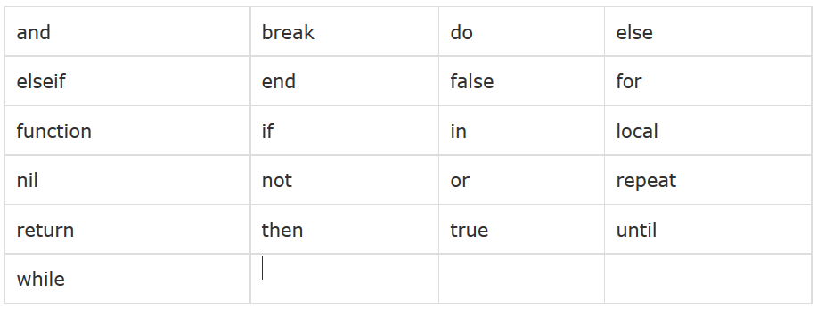
Lua Reserved Words!

Slide 17
DCS WORLD MISSION DESIGN Tutorial 6 – Lua Variables

Slide 18
Scope of the Variables
local
global
Syntax:
local variable
local variable = value
Limit the SCOPE of the variable. If you use local, the variable is only KNOWN in the script, do / end block, and other blocks.
Syntax:
variable = value
No limits on the SCOPE of the variable, which is great!. Note that this has a danger. Global variables can be overwritten somewhere else, because they are … “global” !!!

Slide 19
DCS WORLD MISSION DESIGN Tutorial 7 – Lua Data Types

Slide 20
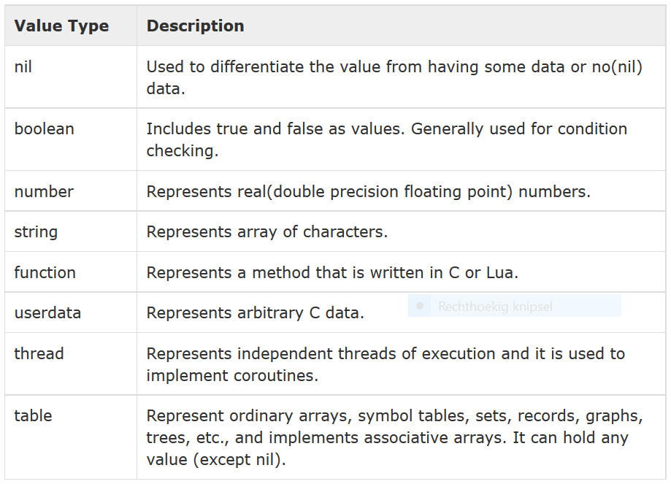
Data Types

Slide 21
DCS WORLD MISSION DESIGN Tutorial 8 – Lua Operators

Slide 22
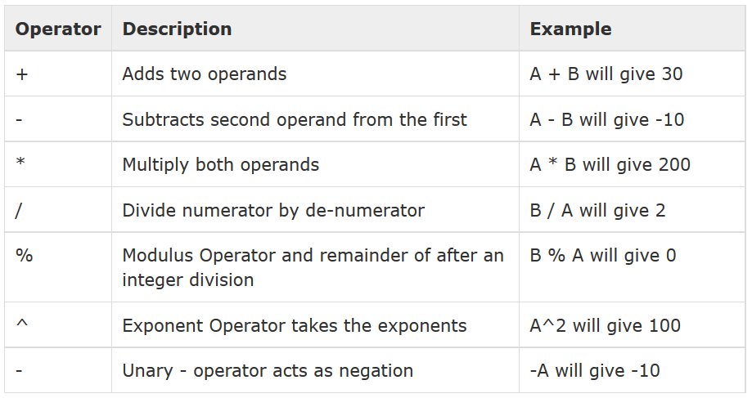
Lua Number Operators

Slide 23
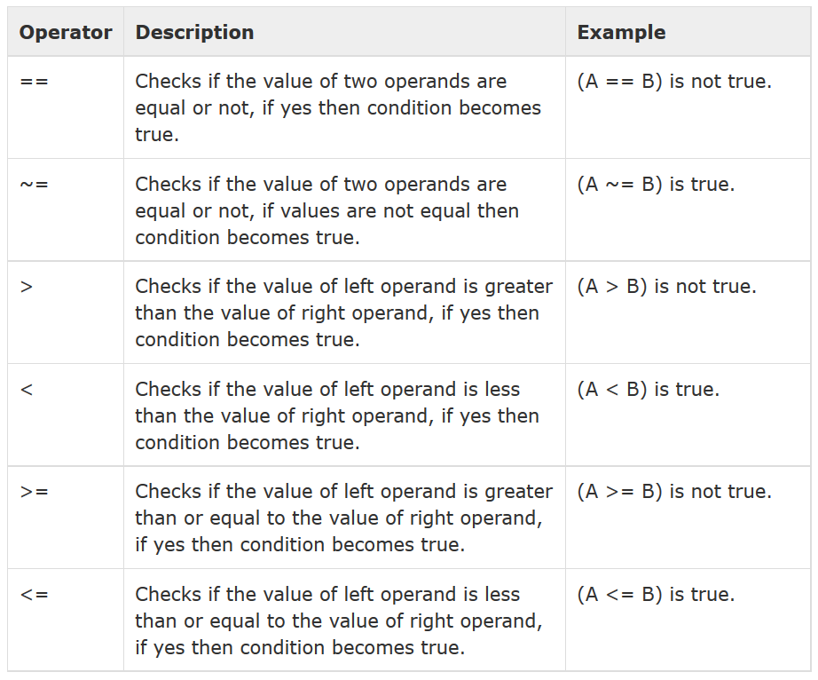
Lua Relational Operators

Slide 24
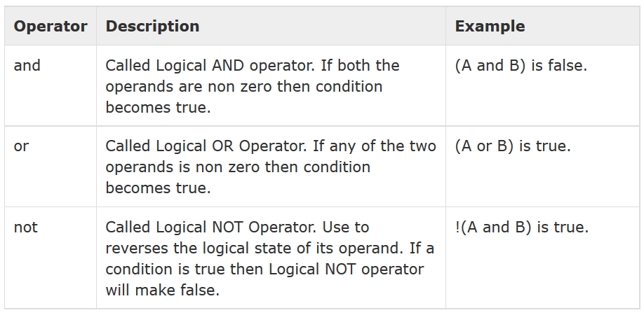
Lua Logical Operators

Slide 25
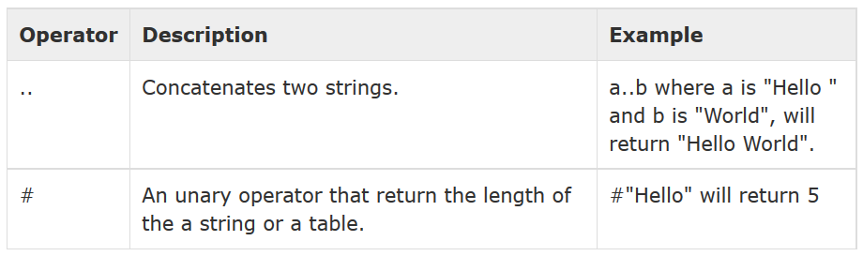
Lua Other Operators

Slide 26
DCS WORLD MISSION DESIGN Tutorial 9 – Lua Loops

Slide 27
DCS WORLD MISSION DESIGN Tutorial 10 – Lua Decision Making

Slide 28
DCS WORLD MISSION DESIGN Tutorial 11 – Lua Functions

Slide 29
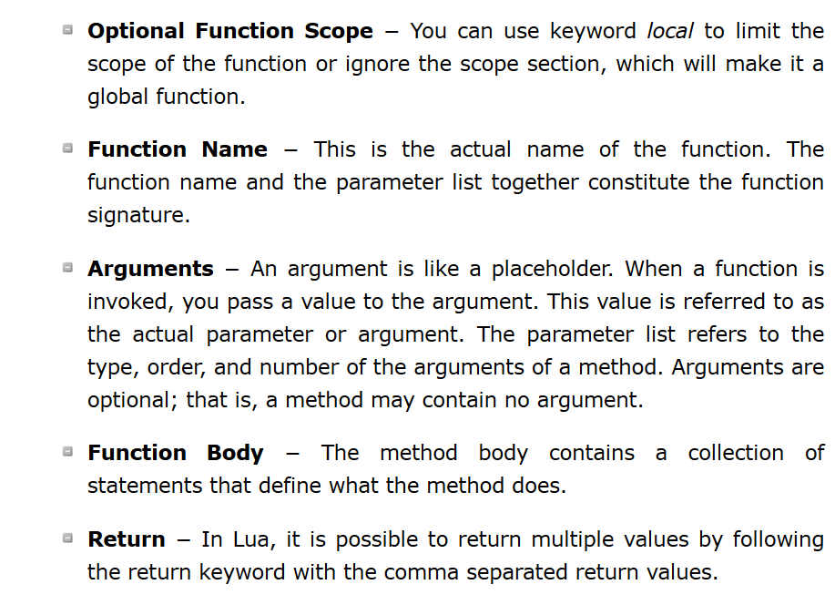
Lua Functions

Slide 30
DCS WORLD MISSION DESIGN Tutorial 12 – MOOSE Overview

Slide 31
flightcontrol_moose@outlook.com

Slide 32
DCS WORLD MISSION DESIGN Tutorial 13 – The MOOSE Community

Slide 33
Contribute on MOOSE
Share
Ideas
Requirements
Proof of Concepts
Create
Deliver
Manage
Issue Management
Design
Coding (Classes)
Document
Mission Design Test
Beta Test
Release
Requirement Management
Communicate
Advertise
Tooling

Slide 34
on SLACK.COM
SLACK.COM (flightcontrol.slack.com)
Special Channels to Share Ideas, Findings, Issues
Sharing of Code
Sharing of Pictures
On Invitation only
=> A PM on ED Forums to FlightControl
=> email to flightcontrol_moose@outlook.com

Slide 35
on GITHUB.COM
GITHUB.COM (flightcontrol-master)
Special Channels to Share Ideas, Findings, Issues
Sharing of Code
Sharing of Pictures

Slide 36
DCS WORLD MISSION DESIGN Tutorial 14 – Lua Reference Material

Slide 37
DCS WORLD MISSION DESIGN Tutorial 15 – Mission 1

Slide 38
DCS WORLD MISSION DESIGN Tutorial 16 – Designate

